Slide 1
Developing Your Program
CFS
10
Second Edition
Updated July 2025

Slide 2
Topics
“CFS Responsibilities” Activity
Steps to Developing Your Program
Program Tools
Making Your Program Inspection Ready
Using Virtual Resources
Touchpoints and FEAPs
Survivor Benefit Plan (SBP)

Slide 3
Topics
Program Support
Maintaining Your Certification
CFS Panel Discussion Panel
FPW Review
Post-test
“What Have You Learned” Activity
Course Wrap-up

Slide 4

Activity – CFS Responsibilities
& Functions
Do you know your CFS responsibilities?
To whom do you report?
Who is your CFS Chain of Command?
SM
10-3
15-3

Slide 5
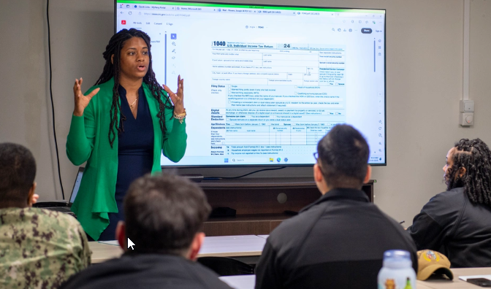
Steps to Developing Your Program
Communicate your program
Assess your program
Establish your program
Maintain your program
SM
10-4
15-3

Slide 6

Communicate Your Program
CFS Team
CFS Chain of Command
ISIC, TYCOM, Region, District, Regiment, or Headquarters

Slide 7

Assess Your Program
Perform a baseline inspection
Use the program checklist
Route results
Retain in program files

Slide 8

Establish Your Program
Engage leadership
Create a CFS Team
Perform a program “Needs Assessment”
Create a program “Battle Rhythm”
SM
TBD

Slide 9
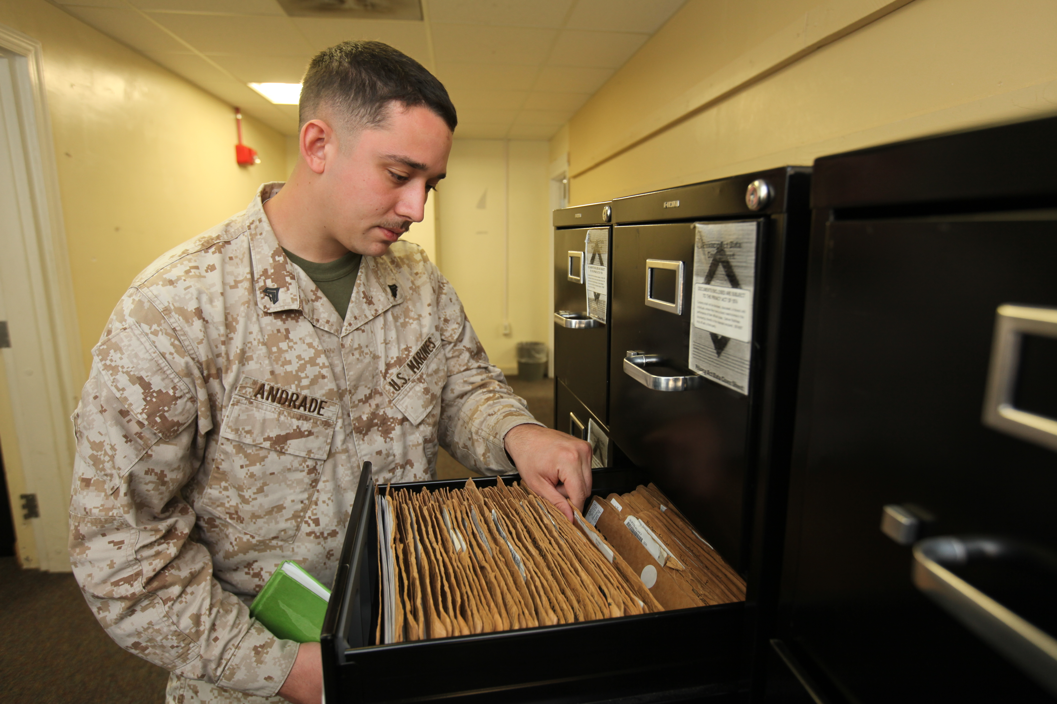
Maintain Your Program
Utilize Outlook calendar to track required reports & meetings
Review program files routinely
Cross-train CFS team
Assess program annually

Slide 10
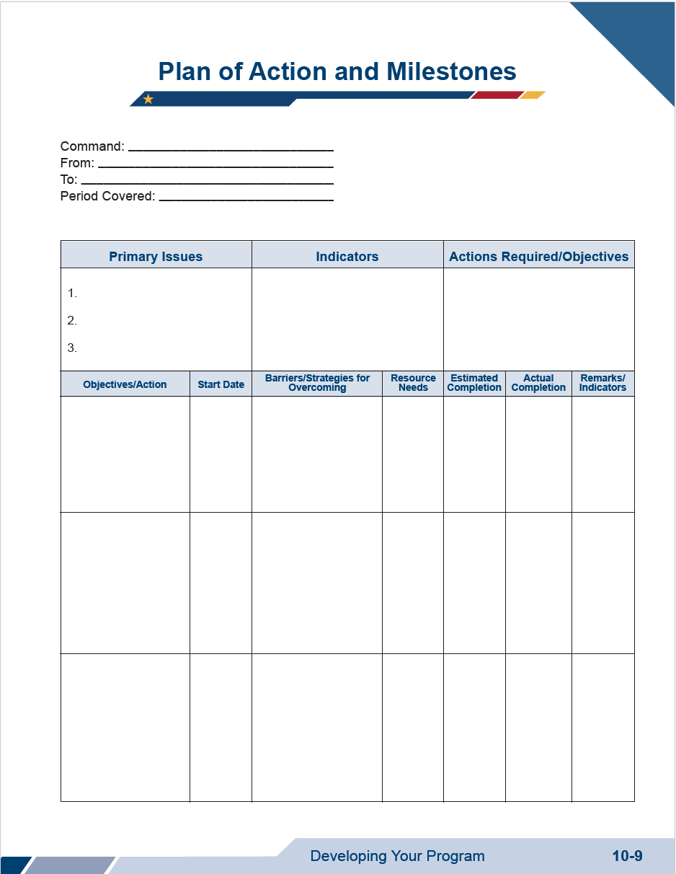
Program Tools: Plan of Action and Milestones
SM
10-9

Slide 11
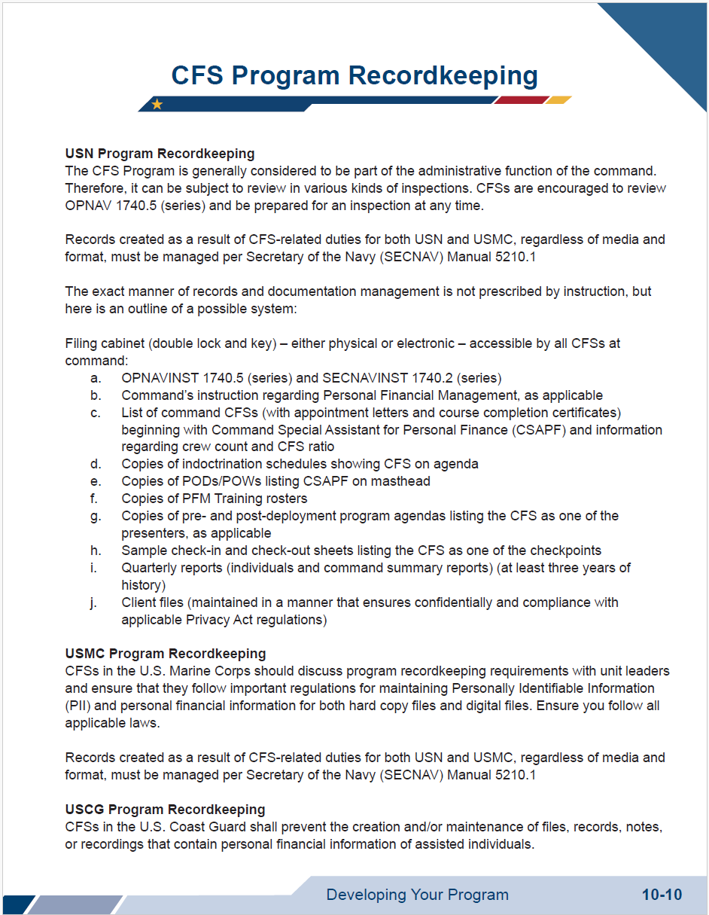
Program Tools: CFS Program Recordkeeping
SM
10-10

Slide 12

Program Tools: Marketing Your Program Activity
SM
10-11

Slide 13

Program Tools: Command Briefs
Command Leadership
  Audience: Command senior leadership
  Content: Goals, expectations, and trends for your program
Command Indoctrination (INDOC)
  Audience: New command members
  Content: Financial training and resources offered at the command

Slide 14

Making Your Program Inspection Ready
Instructions and Policies
CFS Team Qualifications, Trainings, & Records
Program Documentation
Administrative Notes
SM
10-12
15-3

Slide 15


Using Virtual Resources
CFS Virtual Resources
Virtual repository for approved curriculum
Program support material
Service Touchpoints/FEAPs material
CFSs may only use their branch of service's approved PFM Standardized Curriculum and Touchpoint/FEAP Curriculum. CFSs are not authorized to use any other material.
SM
10-14
15-3

Slide 16
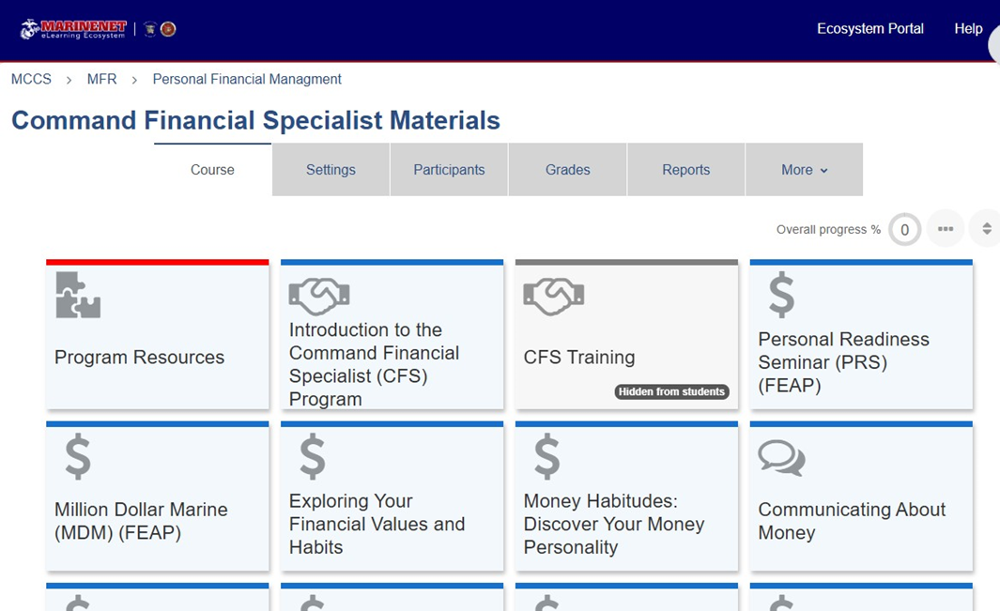

Using Virtual Resources
USMC MarineNet
Within the CFS Materials on MarineNet there are 67 classes available to conduct, including FEAPs and CFS Resources
Please review the classes, to become familiar with the material, should you be asked to present on the various topics

Slide 17
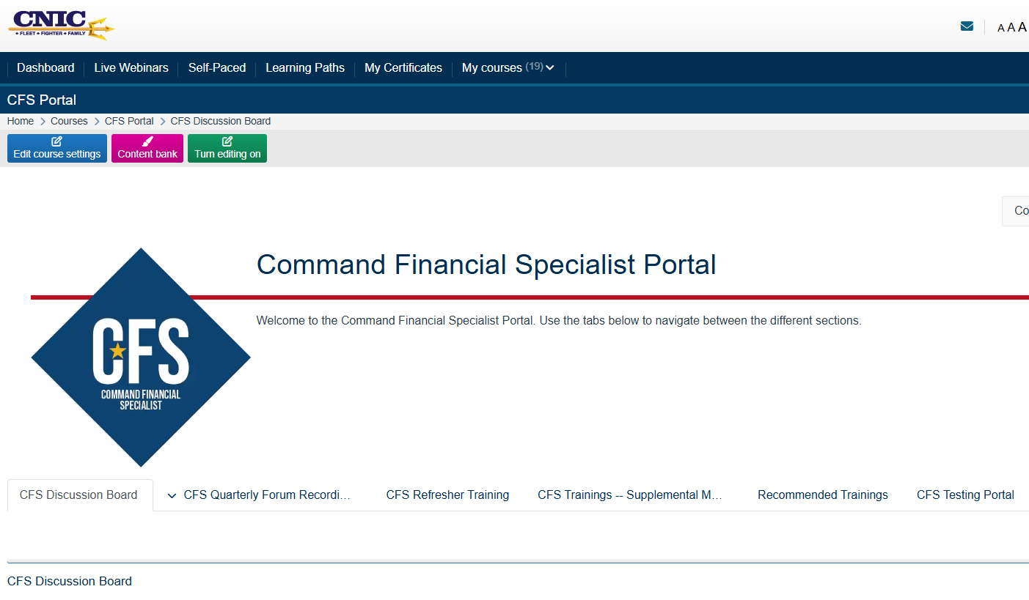





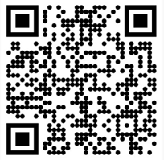



MyNavyFamily Learning Management System

Slide 18

USCG PFMP Registry
Using Virtual Resources
Points of utilizing the Registry:
CFS submit separate worksheets for all their assigned units monthly.
Submit worksheets even if no training or contacts occurred.
Final monthly worksheet submitted by 10th of each month following the reporting month.
Submit your CFS certificate to your Training Officer and ask them to enter your CFS Competency Code into Direct Access.

Slide 19



Touchpoints/FEAPs
USN
Material Location
DoD LRL-APAN
Completion Options
1-on-1 with a PFM or CFS
Group Training
Virtual Self-paced
Self-paced
MyNavy Financial Literacy Mobile APP
Navy eLearning
USMC
Material Location
Marine Net
Completion Options
1-on-1 with a PFM or CFS
Group Training
Self-paced
No Self-paced Options at This Time
USCG
Material Location
DoD LRL-APAN
Completion Options
1-on-1 with a PFM or CFS
Group Training
Virtual
Self-paced
USCG Online World of Learning (OWL)
SM
10-18
15-3

Slide 20
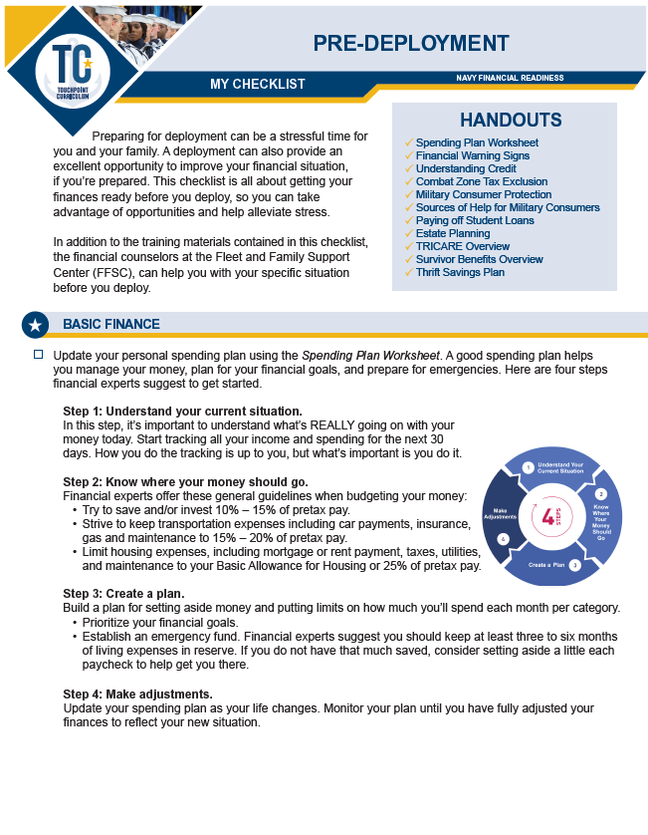
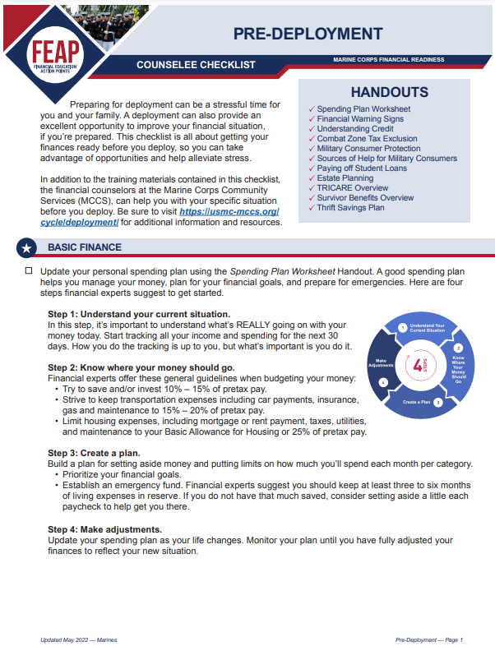
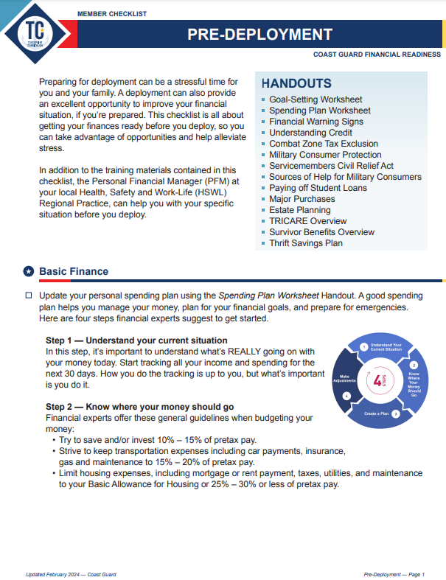
Touchpoints/FEAPs Material

Slide 21

Survivor Benefit Plan Video

Slide 22
Survivor Benefit Plan – Active Duty
Examples:
SBP Options
Former spouse by court order
Current spouse
Children
HM1 Bieri is married with two kids and passes away while on deployment.
Costs
FREE
AVG E6 base pay over 36 months
multiplied by 75% & 55%
$4097.66 X .75 X .55
Survivor Payment
55% of Retired Pay Retired pay is calculated as if Service member retired with 100% disability. Base pay is multiplied by 75%.
Survivor receives $1,690.28 Monthly*
*There are conditions the spouse must follow to continue to receive monthly payment

Slide 23
Survivor Benefit Plan – Retiree
Examples:
SBP Options
Spouse*
Former spouse
Child
Spouse & Child
Insurable Interests
No Beneficiaries
At retirement, the member selects:
Spouse Only with full retirement pay coverage (55%)
Costs
Cost depends on option chosen at retirement
For this example, Spouse Only SBP costs are 6.5% of monthly retired pay
Monthly retired pay = $3,000
SBP monthly costs = $195
Paid-up Age 70 & 30 years of payments
Payments Stop @ spouse death or divorce
Survivor Payment
Can receive up to 55% of retired pay
*Full SBP pay coverage
Retiree passes away
Survivor receives = $1,650 monthly
*Will receive yearly COLA increase
*If married at retirement, spouse must decline

Slide 24
CFS Program Support
  Fleet and Family
  Support Center
  Marine and Family
  Programs
  Office of
  Work-Life
  Community Resources
  Authorized Organizations
SM
10-23
15-3

Slide 25
Maintaining Your CFS Certification
Service Specific
Command Reports
CFS Quarterly Forums
Advance Training
CFS Refresher Course
SM
10-24
15-3

Slide 26

FPW Review

Slide 27

CFS Panel Discussion

Slide 28

Post-test
70% or higher required
Paper or virtual format depending on branch of service

Slide 29
Activity: What Have You Learned?
What did
you like?
What would you change?
Positive
Negative

Slide 30

Wrap Up: Course Evaluations
Refer to CFS 1 Student Manual page 1-8 to complete the course evaluation
Survey completion

Slide 31
Graduation
You have completed the CFS Certification Course Track and are on your way to becoming a CFS!

